Slide 1


Fake News
Detection
By Vered Klein,
Dana Markiewitz
and Sigal Graboys.
https://github.com/sigalgrabois/ADS_final_project

Slide 2
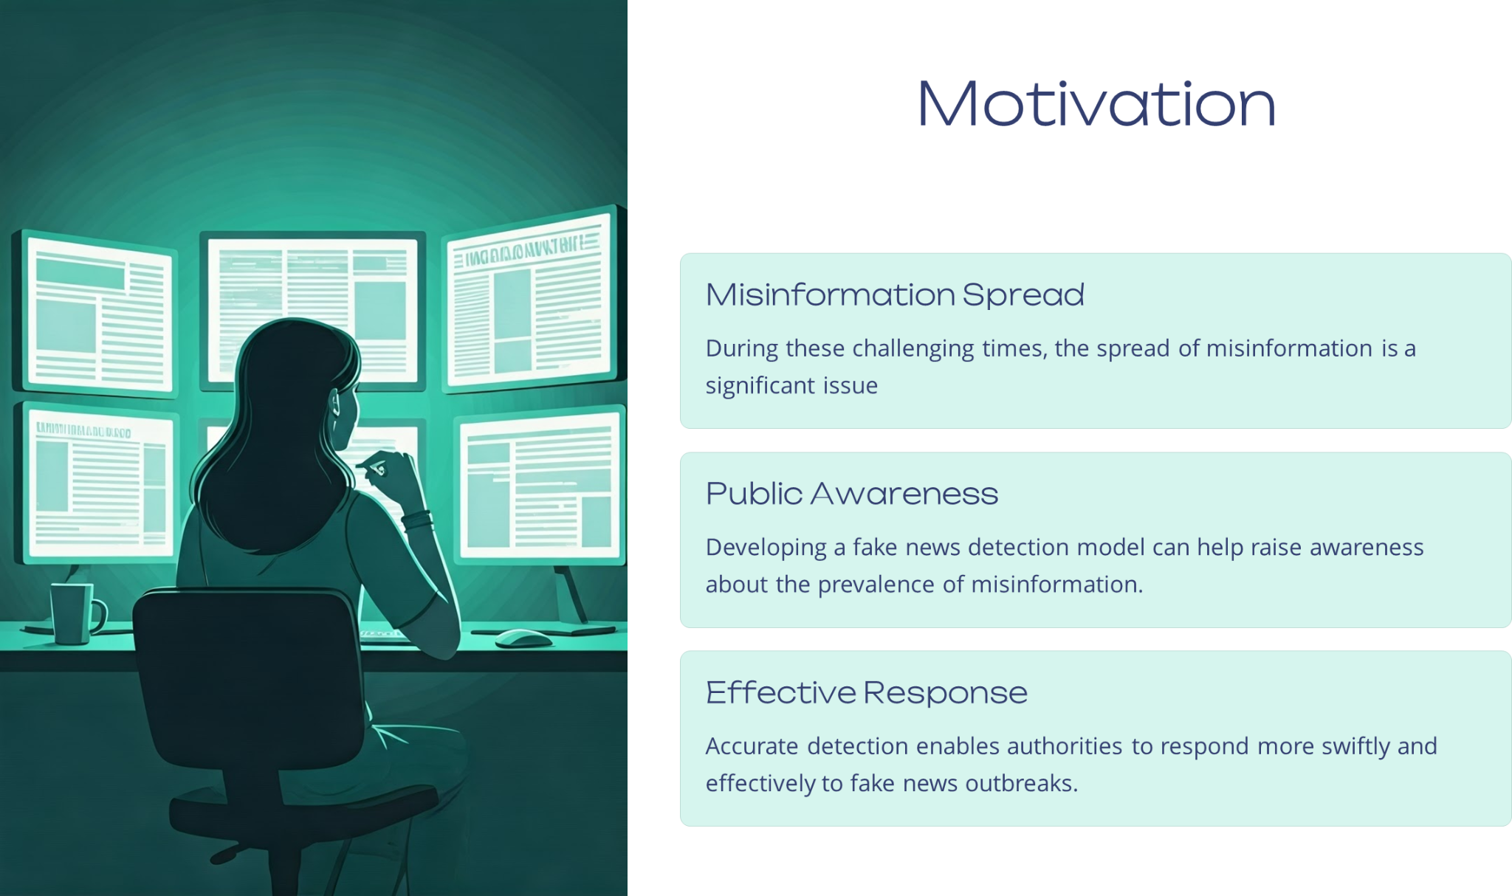
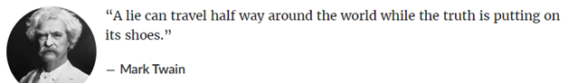
Notes:
Fake news detection has become a critical issue in the digital age, impacting political
stability and public perception. We chose this topic because we observed a
significant amount of fake news during the Iron Swords War between Israel and
Gaza. This topic is highly relevant and important to us because fake news can lead
to misconceptions of the truth, and we want to address this issue. To tackle this
problem, we have chosen the LIAR dataset, a robust foundation for developing
models that can detect fake news by analyzing short statements from various
sources.

Slide 3
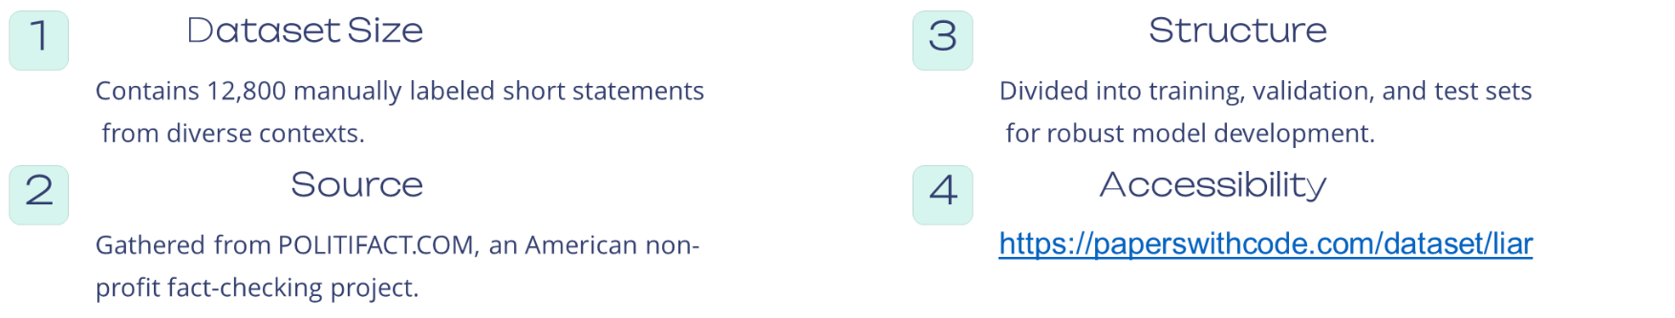
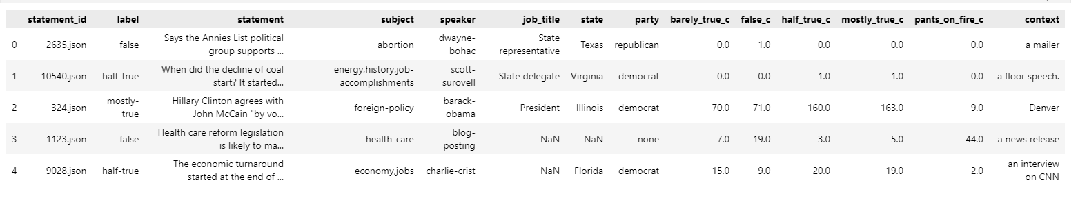
LIAR Dataset
Notes:
Source, scraping method, cleanup, storage, etc.

Slide 4
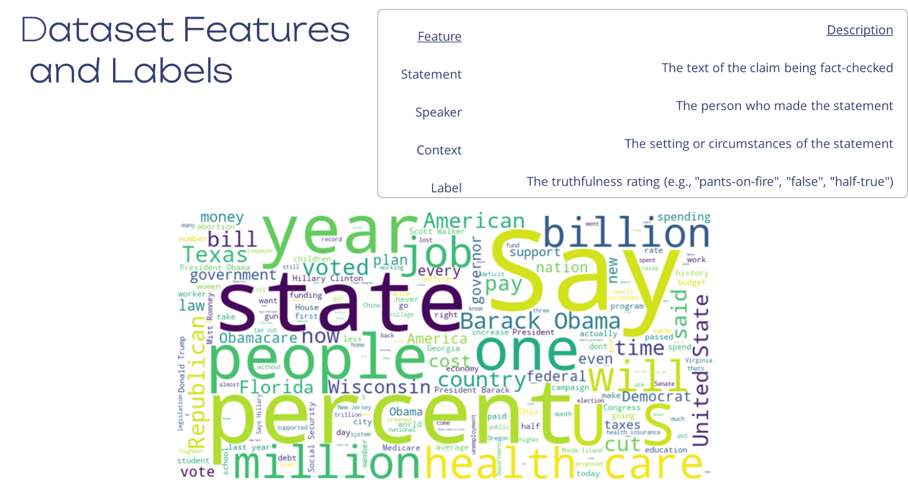

Slide 5
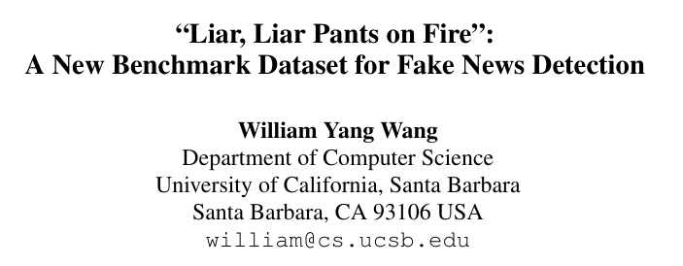
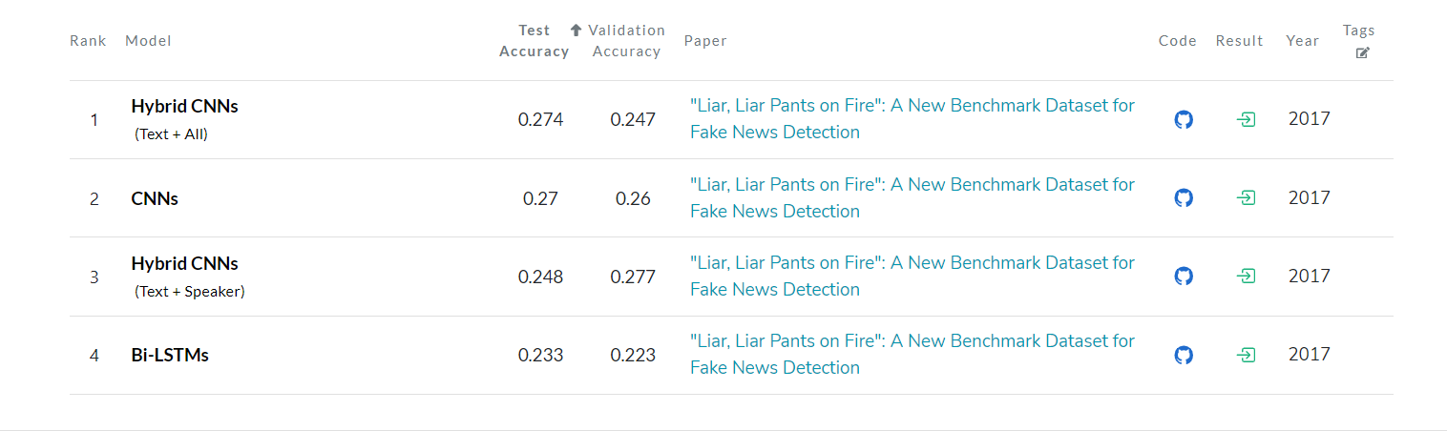
Related Work:
Notes:
צריך להבין טוב את הדאטה ואת העניין של הaucc למה זה בסדר שזה נמוך בצורה משמעותית

Slide 6

Initial questions :
What are the key features that influence the truthfulness of a statement?
Can we measure a speaker’s credibility using a credibility score?
Can we use Doc2Vec embeddings to capture semantic meanings of the text and improve predictions?
How do statement length and complexity correlate with truthfulness?
Can topic modeling help identify patterns between truthful and false statements?
Notes:
What questions are you trying to answer? How did these questions evolve over the course of the project? What new questions did you consider in the course of your analysis?

Slide 7
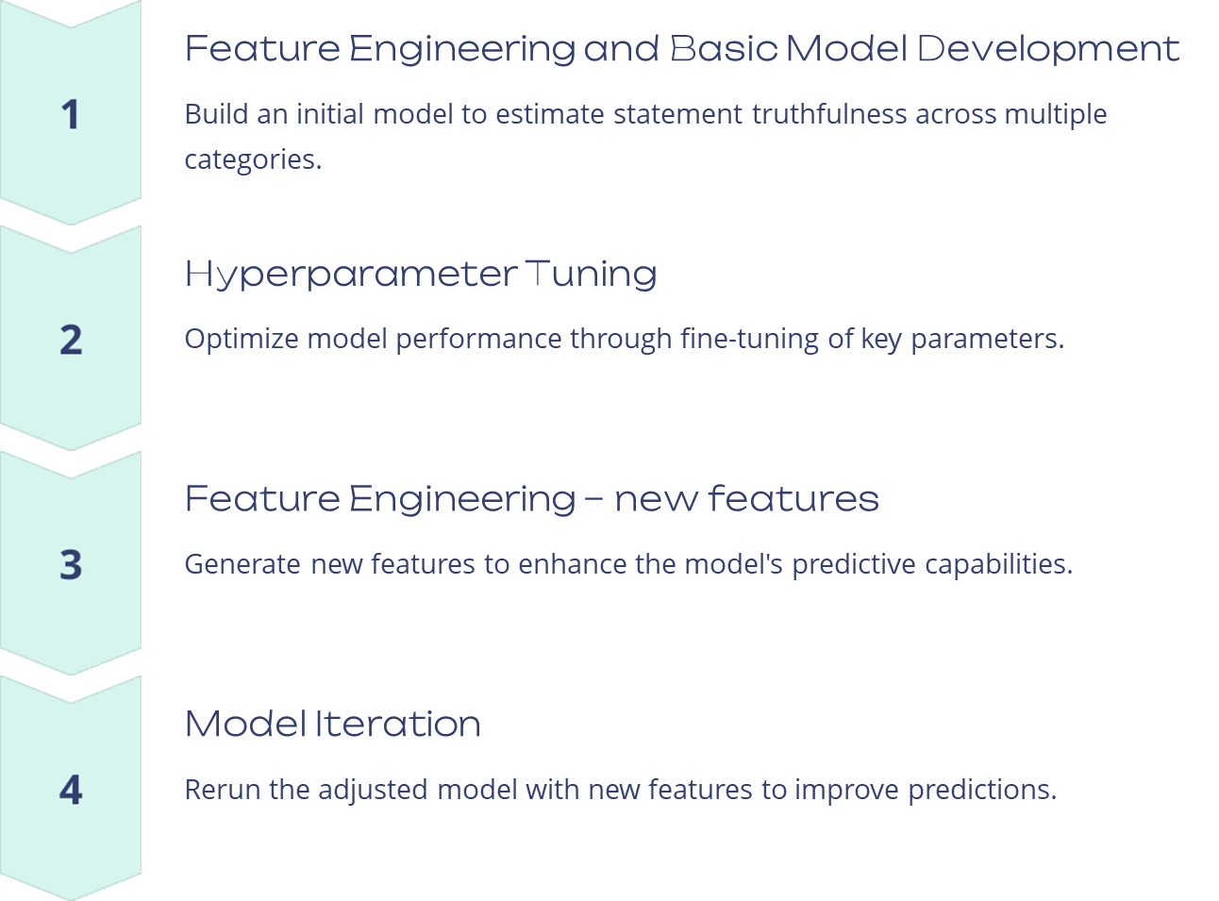
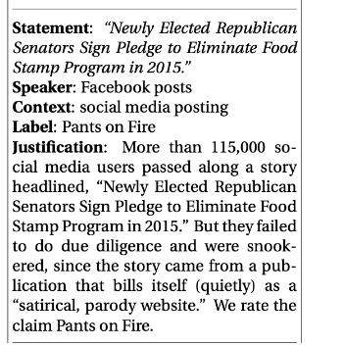
Main Goal:
To detect fake news by predicting the Truthfulness of the statements.

Slide 8
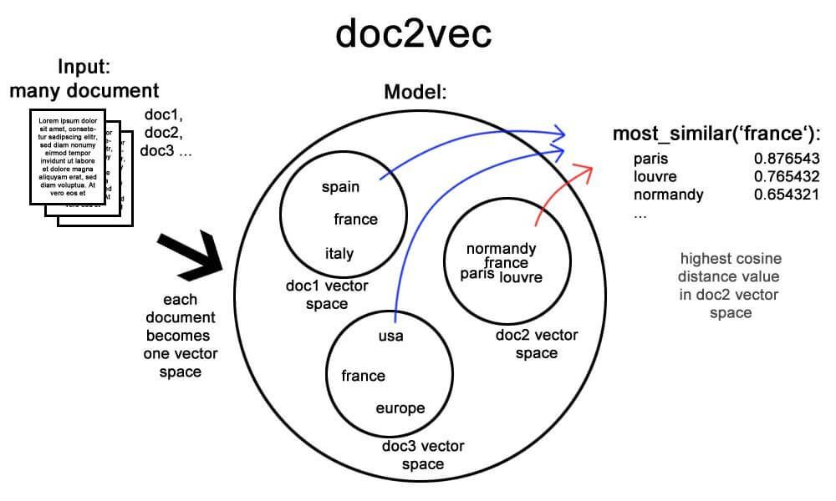
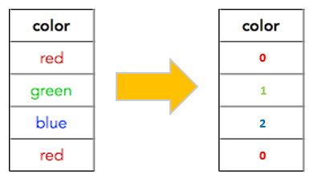
Feature Engineering :
Converting categorical features, to numeric features:
Label Encoding:
Party
Doc2Vec Embedding:
Subject
Job Title
Context
Distributed Representations of Sentences and Documents, Le and Mikolov (2014) https://proceedings.mlr.press/v32/le14.pdf
Notes:
https://x.com/gp_pulipaka/status/996018799555072000/photo/1 Subject (Doc2Vec Embedding): Converts textual data of subjects into vector representations, allowing the model to understand semantic relationships between subjects.
Job Title (Doc2Vec Embedding): Similar to subjects, job titles are transformed into vector embeddings to capture job role semantics.
Party (Label Encoding): This categorical feature is converted into numeric values, where each party label is assigned a unique integer.
Context (Doc2Vec Embedding): Converts contextual information into vector representations, allowing the model to grasp the overall meaning of the context.
By encoding categorical variables into numerical labels, we can create new features that capture the relationships between different categories, enhancing the predictive power of our models.

Slide 9
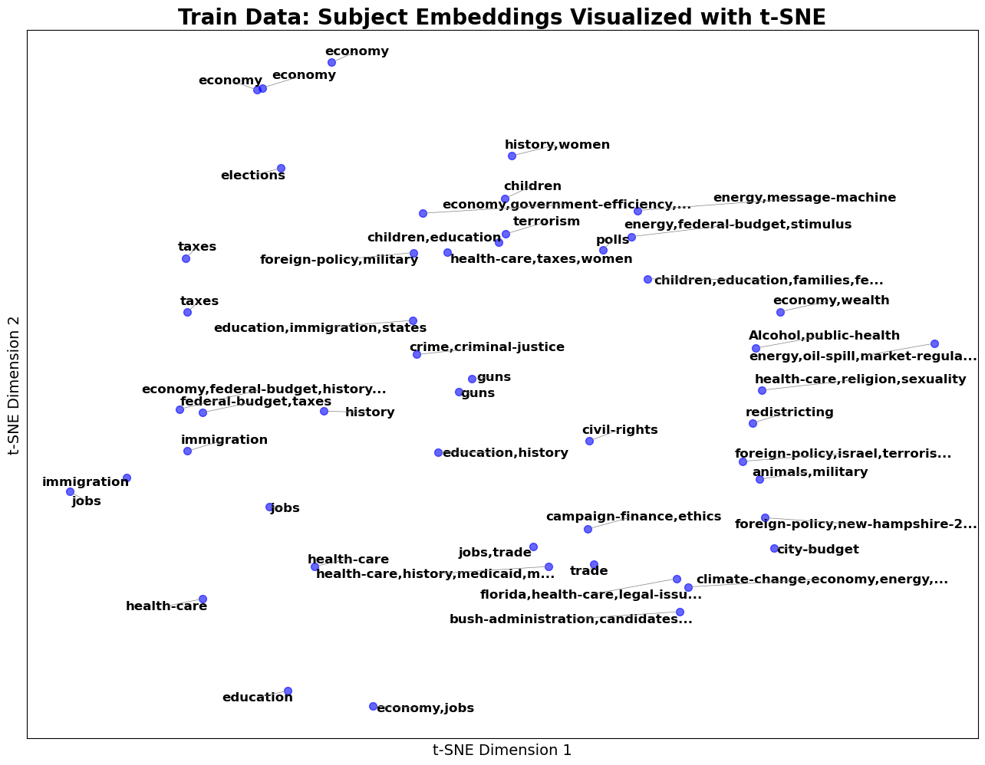
Feature Engineering :
Subject, Doc2Vec DBOW (Distributed Bag of Words)
Notes:
We use Doc2vec embedding to convert the subject’s textual data into numerical vector representations. This transformation helps capture the semantic relationships between different subjects, allowing the model to understand the meaning behind the subject data.

Slide 10
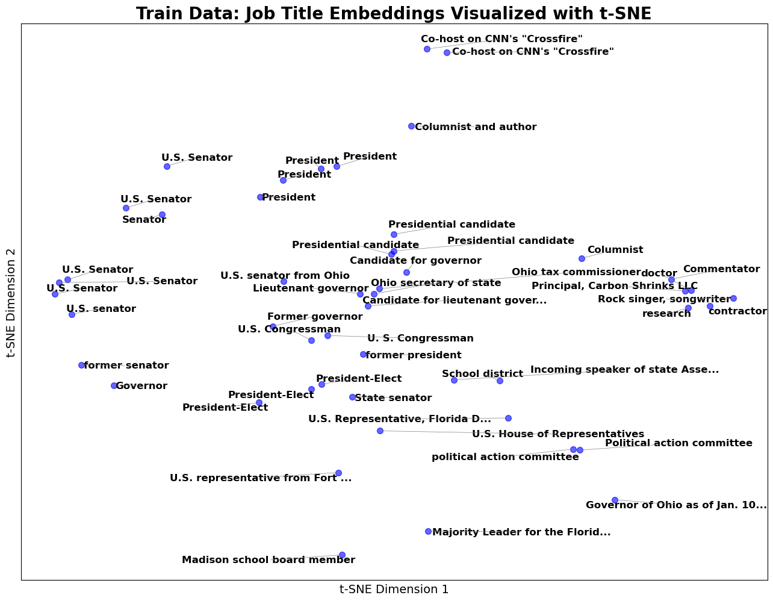
Feature Engineering :
Job title, Doc2Vec DM (Distributed Memory)
Notes:
Job titles are transformed into vector embeddings using Word2Vec, just like subjects. This captures the semantic meaning of various job roles, allowing the model to differentiate between different job functions and relationships between them.
Job titles are transformed into vector embeddings using Word2Vec, just like subjects. This captures the semantic meaning of various job roles, allowing the model to differentiate between different job functions and relationships between them.

Slide 11
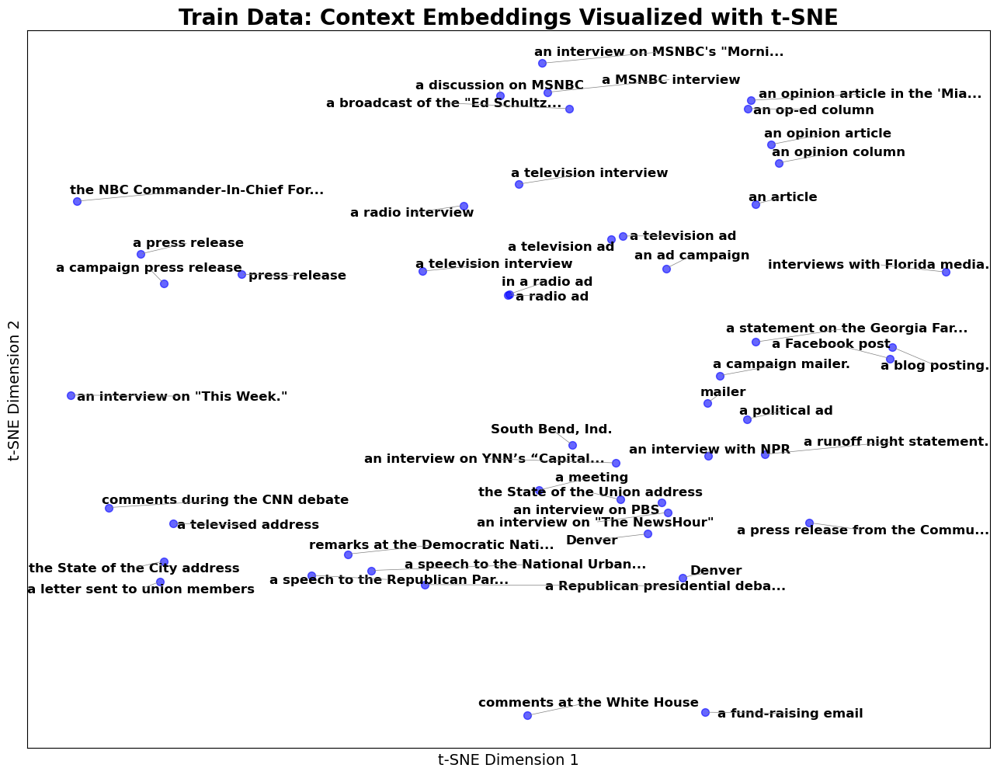
Feature Engineering :
Context, , Doc2Vec DM (Distributed Memory)
Notes:
The ‘context’ data is represented as vectors using Doc2Vec. This enables the model to capture the overall meaning of the context and leverage this understanding when making predictions, enhancing the model's ability to work with complex text-based data.

Slide 12
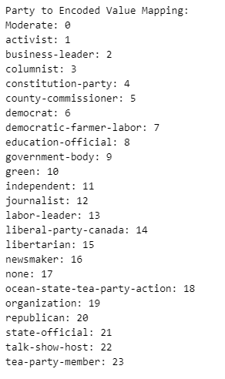
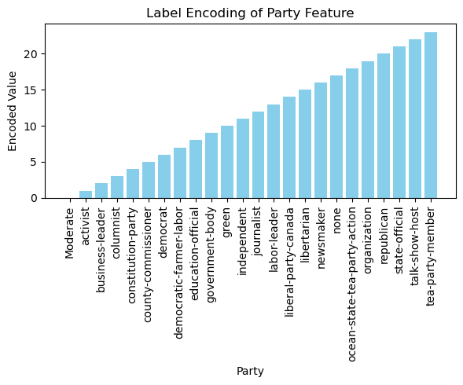
Feature Engineering : Party
Notes:
We apply Label Encoding to the ‘party’ feature. Each party is assigned a unique integer, converting the categorical data into a numerical format that can be processed by the machine learning model. This ensures the model understands and uses party affiliation effectively in its predictions.

Slide 13
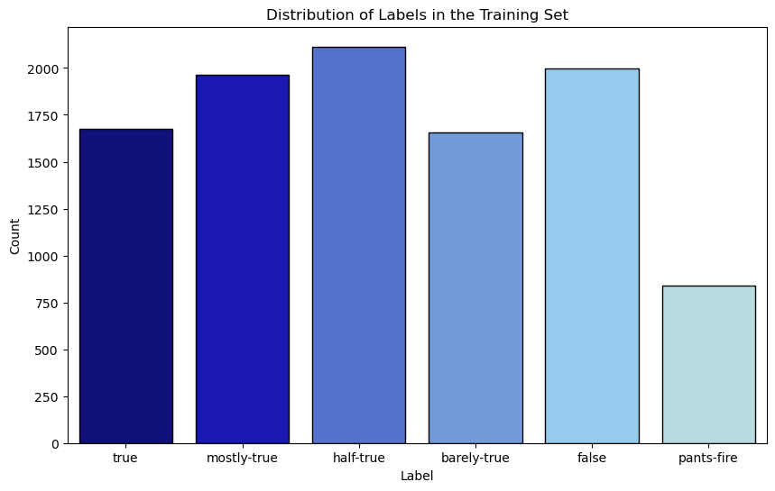
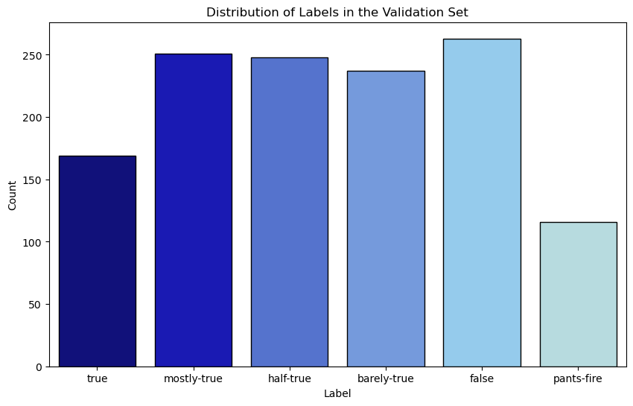
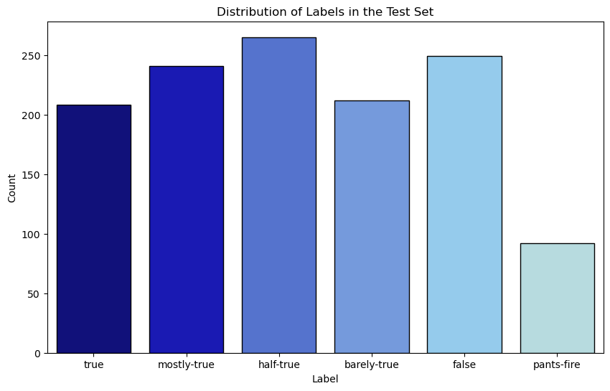
EDA
Notes:
What visualizations did you use to look at your data in different ways? What are the different statistical methods you considered? Justify the decisions you made. How did you reach these conclusions?

Slide 14
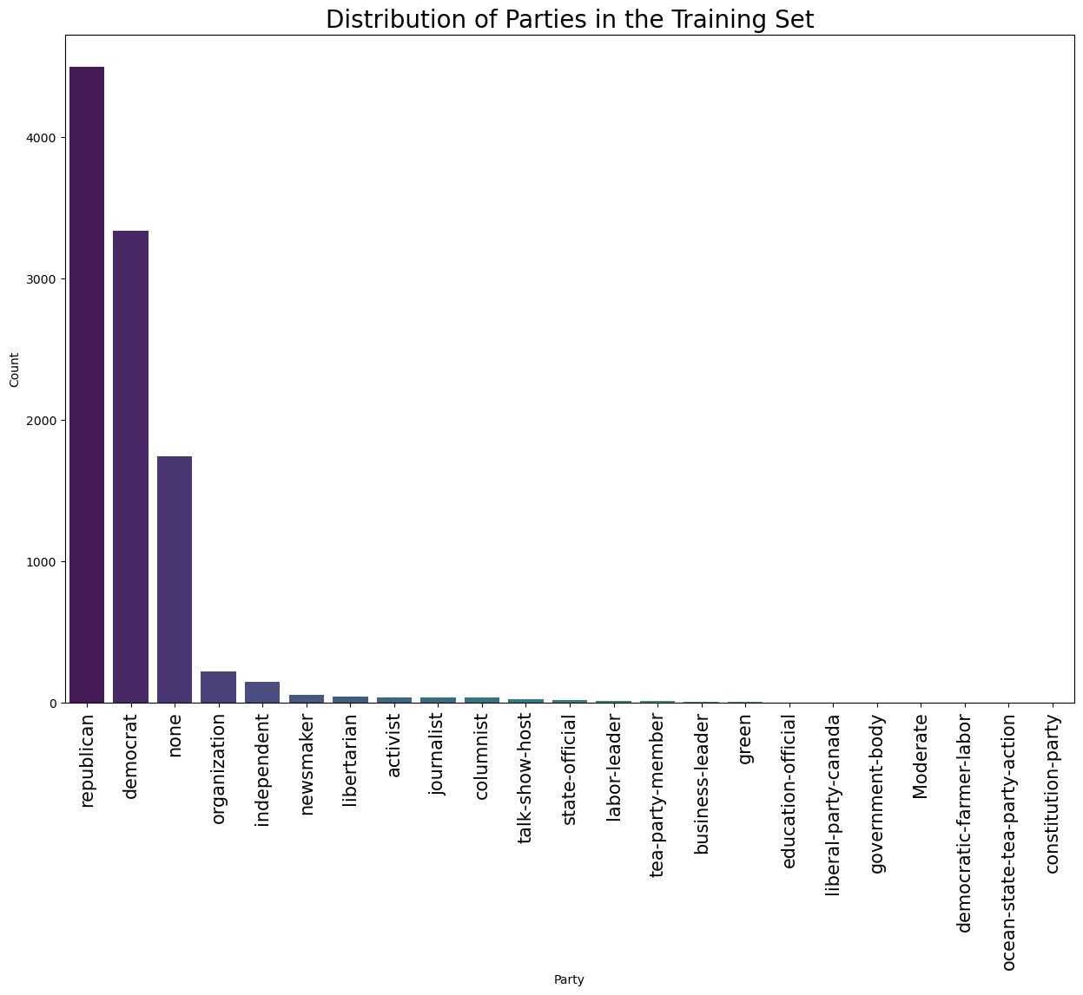
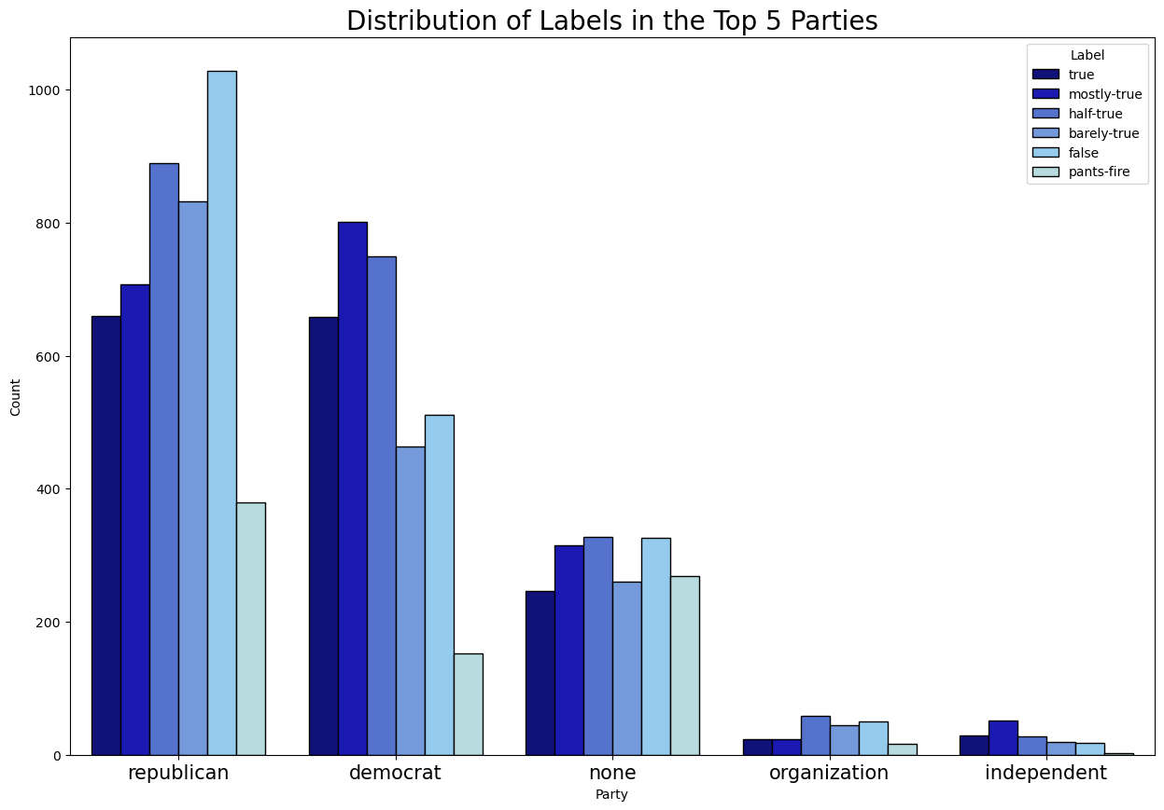
EDA

Slide 15
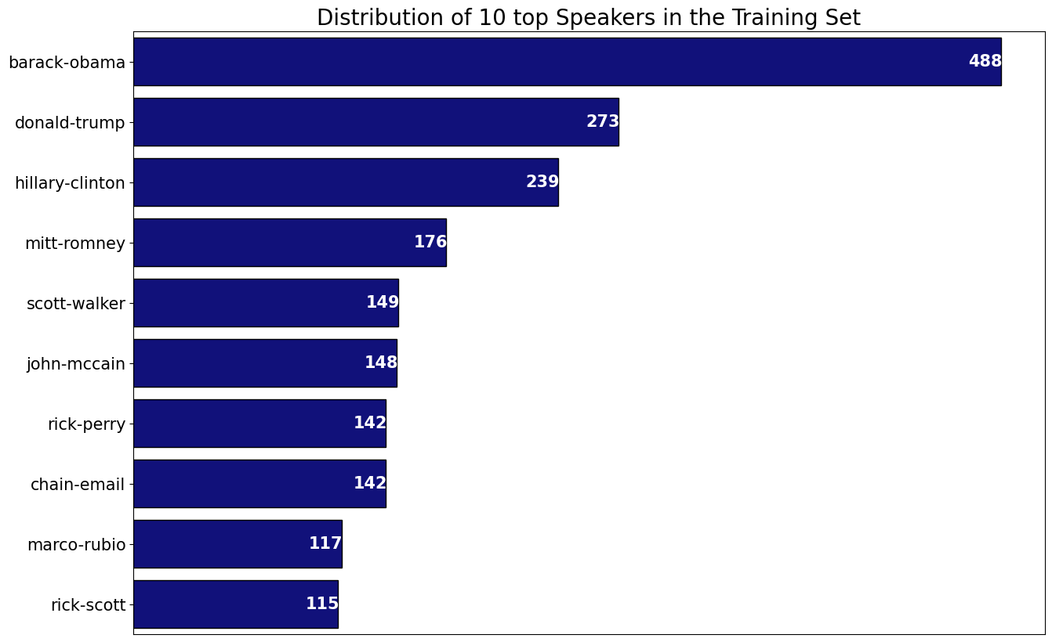
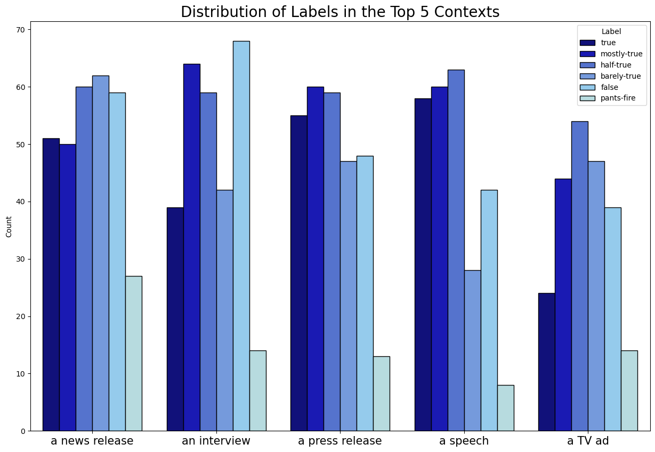
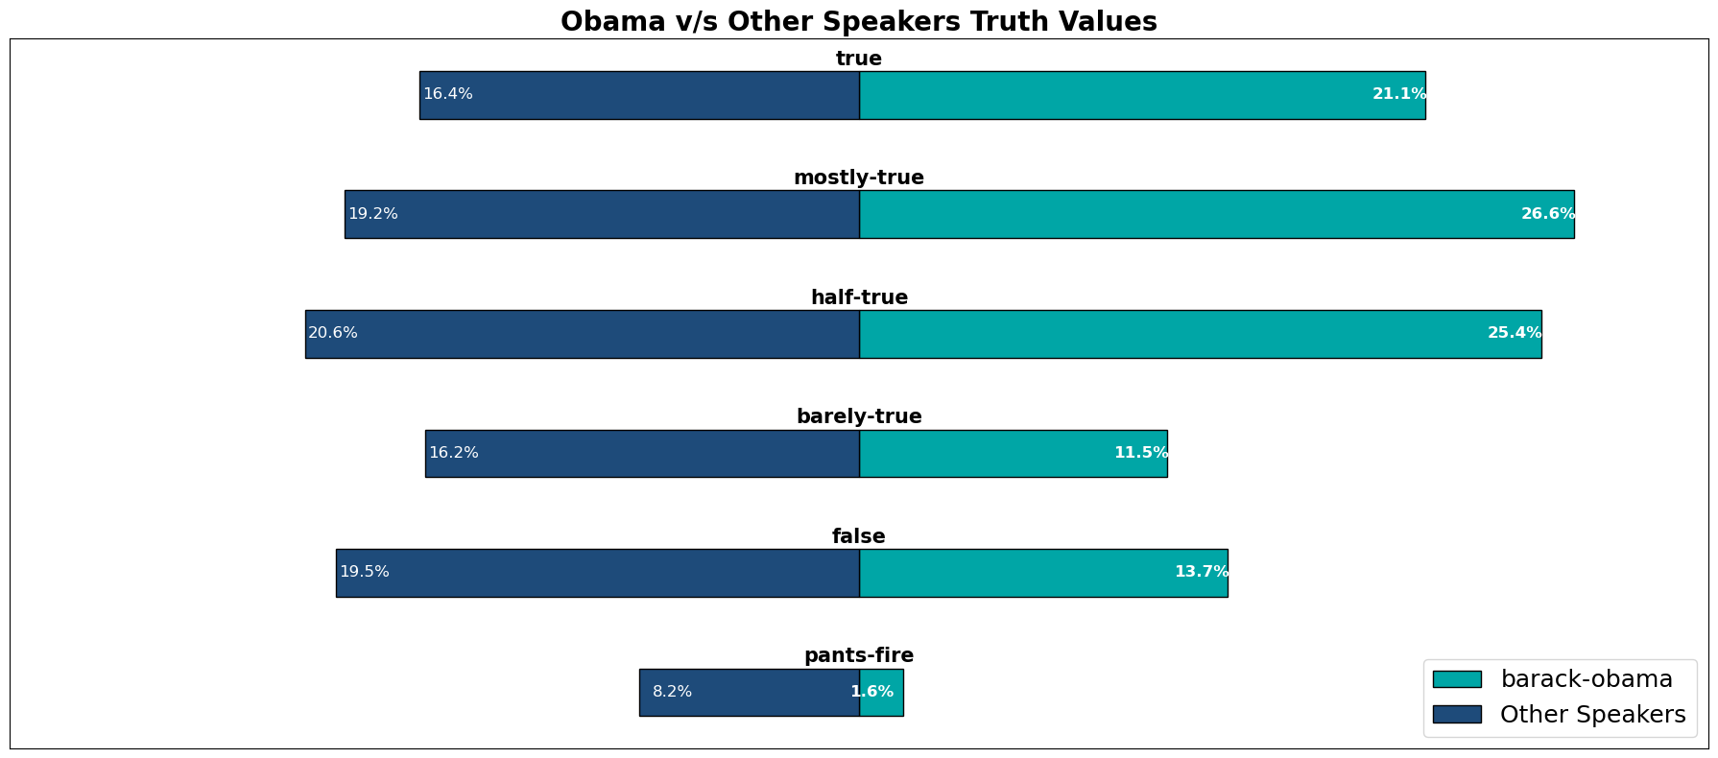
EDA

Slide 16
Cleaning Data:
Remove samples with NaN values in most of features (2 samples).
Feature Selection

Slide 17
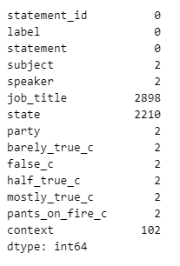
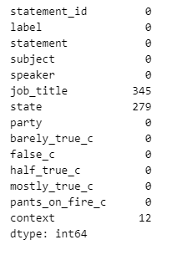
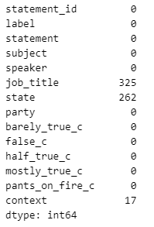
Cleaning Data:
train_data
valid_data
test_data
Removed rows with Nan in most of the features.

Slide 18

Cleaning Data - Feature Selection:
Context
State
Job Title
Speaker

Slide 19
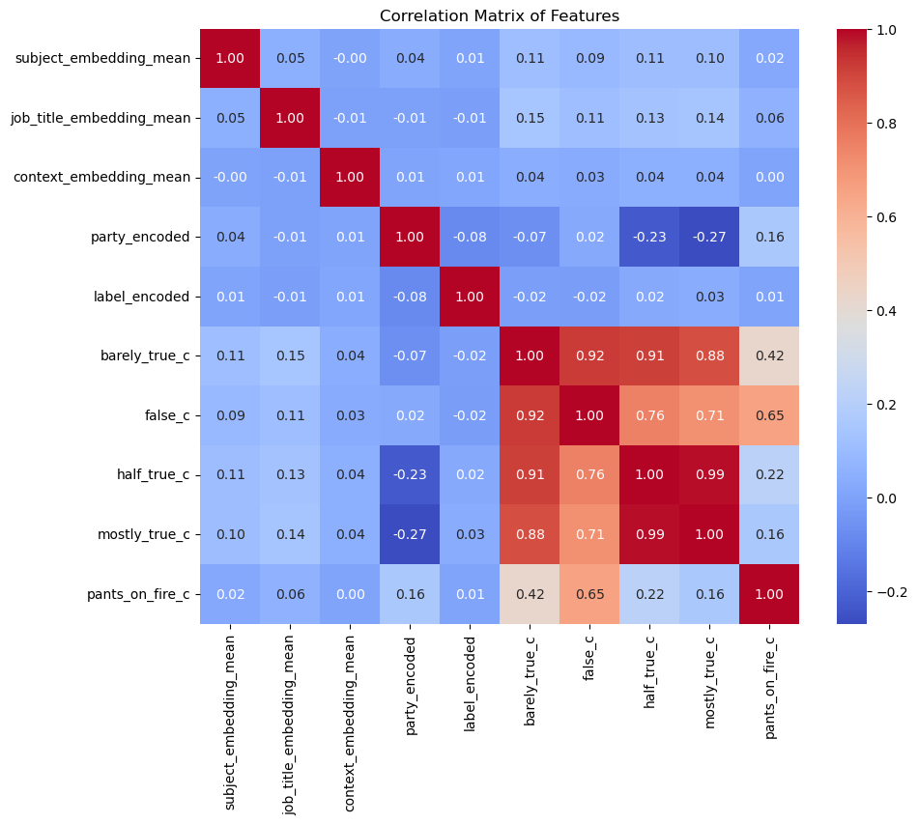
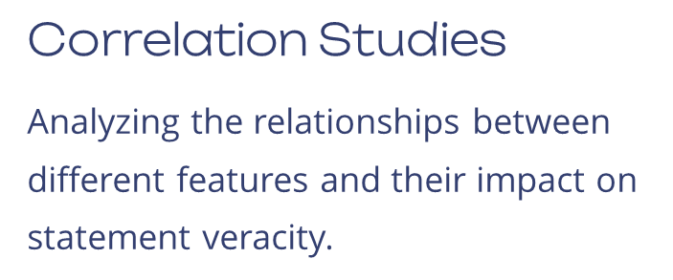
Statistical Analysis

Slide 20
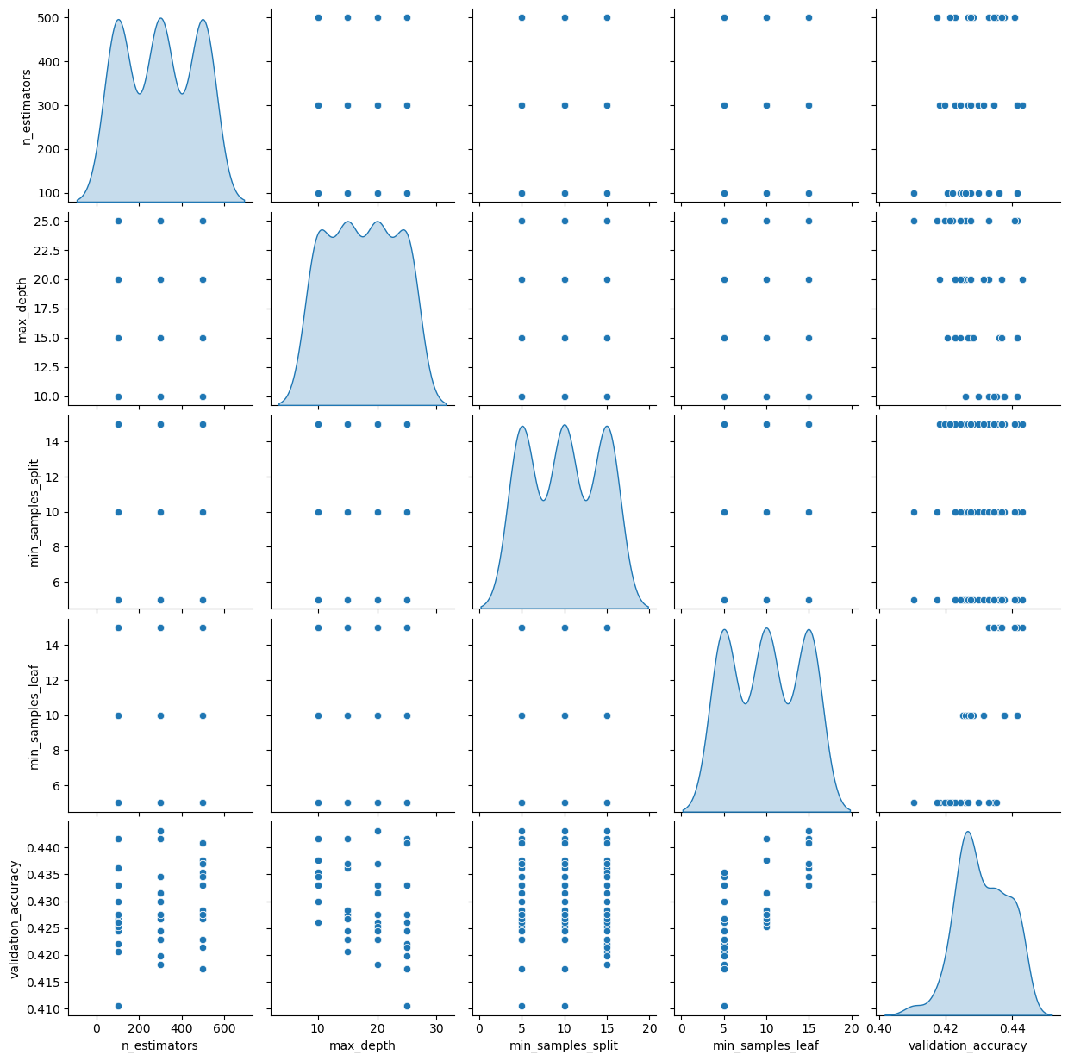
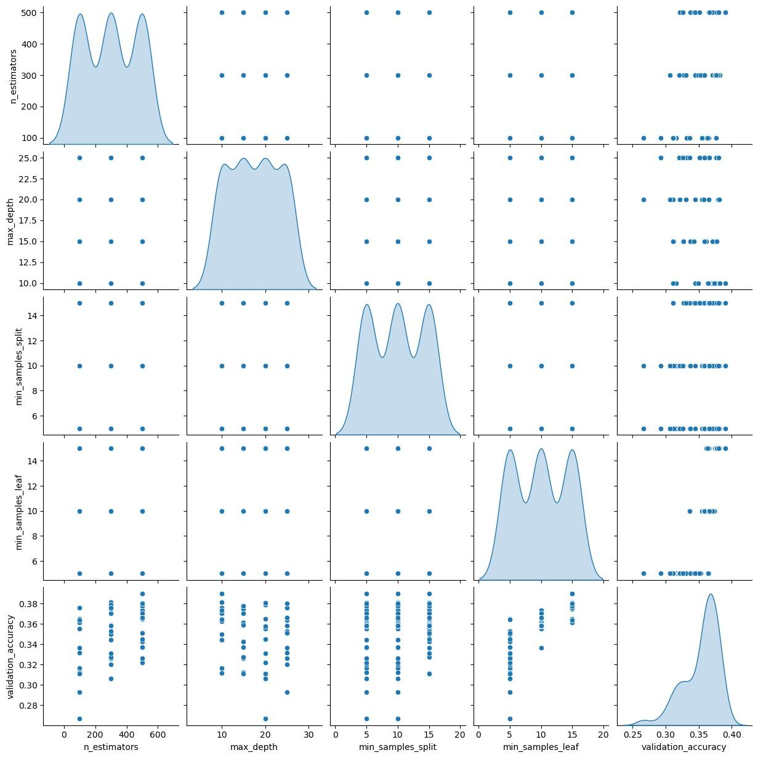
Basic Model:
Hyperparameter
Tuning
n_estimators = 300
max_depth = 20
min_samples_split = 5
min_samples_leaf = 15

Slide 21
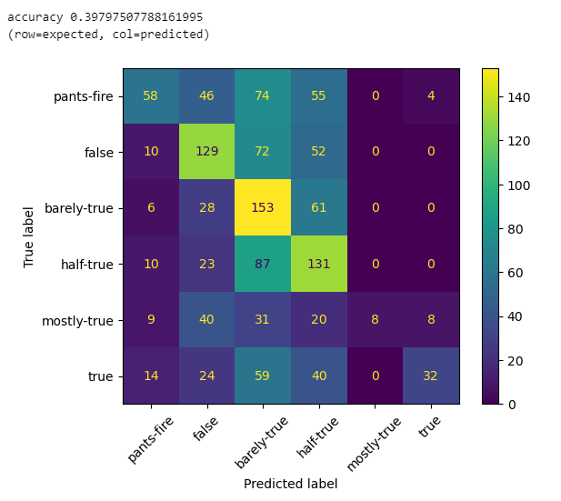
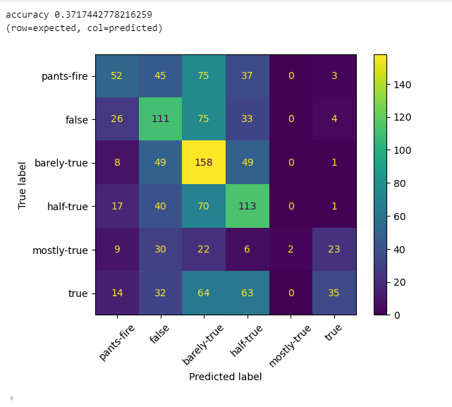
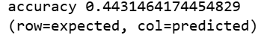
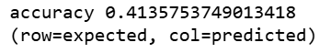
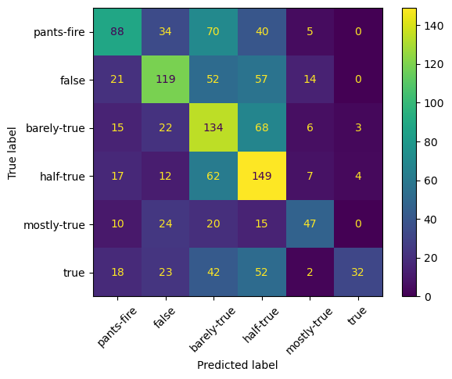
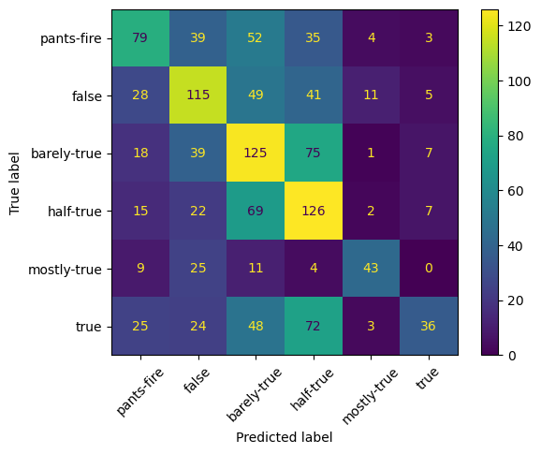
Basic Model: Random forest
valid_data
test_data
Notes:
Build an ML model that you expect to serve as a strong baseline. Perform performance analysis and error analysis on its results, and learn from it how to make it better.

Slide 22
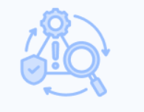
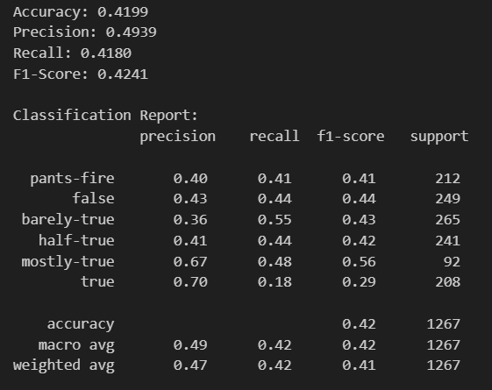
Error Analysis - Test data set
Notes:
The model performs better for the "false" and "mostly-true" classes but struggles with the "true" class due to low recall (only 18% of true samples are correctly detected).
The overall performance, with an accuracy of around 42%, indicates that there's room for improvement, especially in balancing precision and recall.
1. Precision
Precision answers the question: "Of all the predictions my model made as positive (or for a particular class), how many were actually correct?"
2. Recall
Recall answers the question: "Of all the actual positives (or a particular class), how many did my model correctly identify?"
Recall focuses on how comprehensive the model is in finding all the positive cases

Slide 23
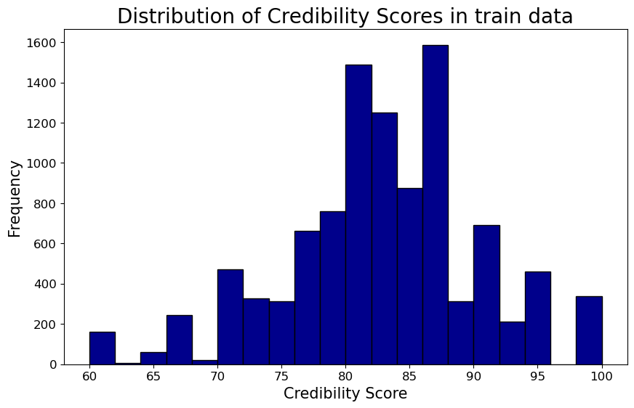
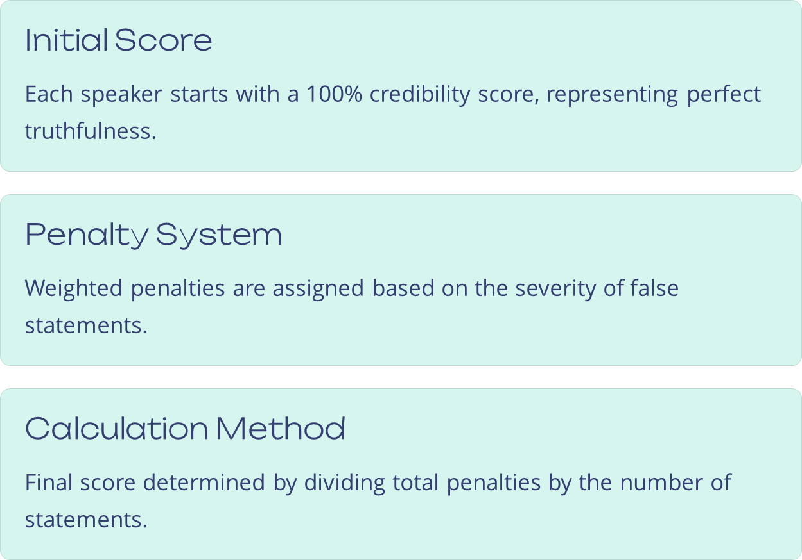
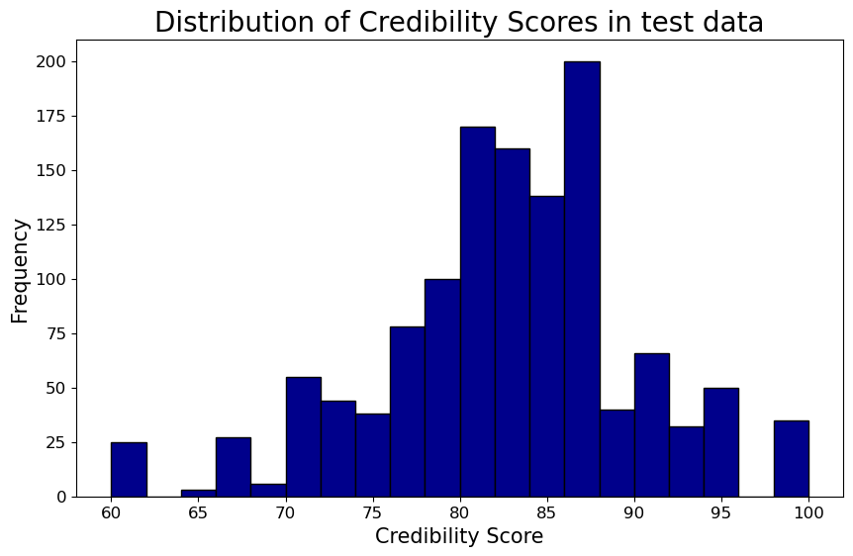
New Feature: Credibility Score (%)
Notes:
The credibility score starts at 100% and decreases based on the severity of false statements. It's calculated by assigning weighted penalties to each type of label and dividing by the total number of statements for each speaker.

Slide 24
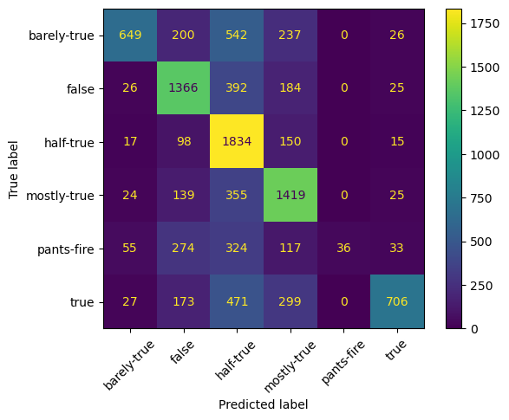
New Feature: TF-IDF
Evaluates the importance of each word in the statement relative to all statements, by considering how frequently it appears in the statement (TF) and how unique or rare it is across all statements (IDF).
Notes:
tf–idf is the product of two statistics, term frequency and inverse document frequency.

Slide 25
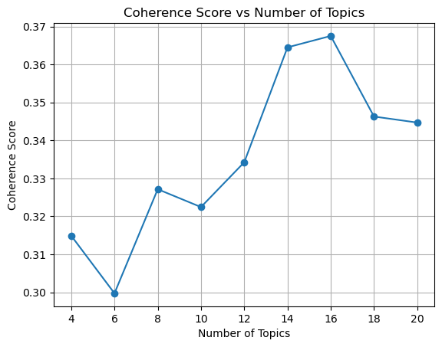
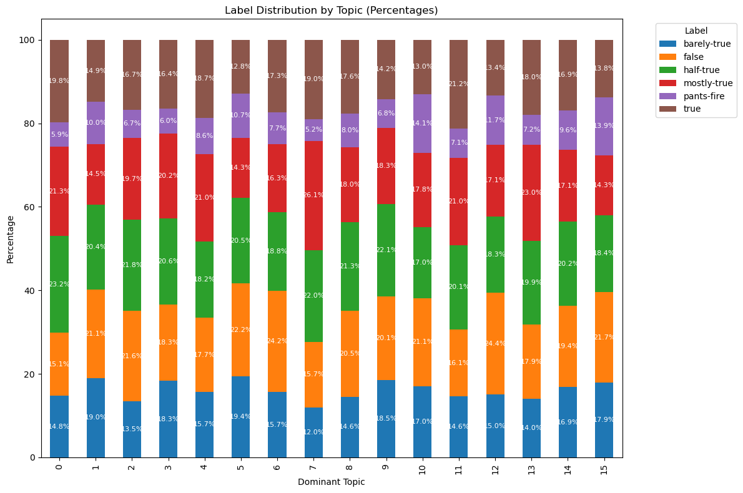
New Feature: Topic Modeling

Slide 26
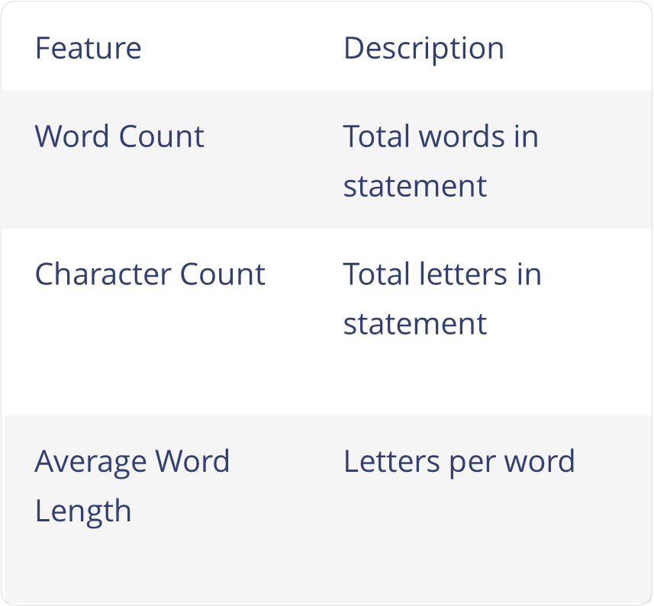
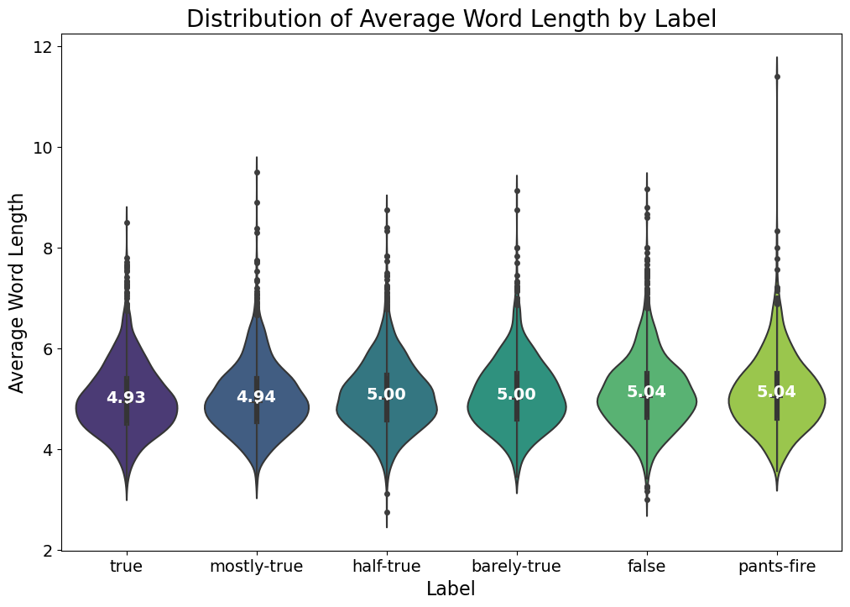
New Features: Length

Slide 27
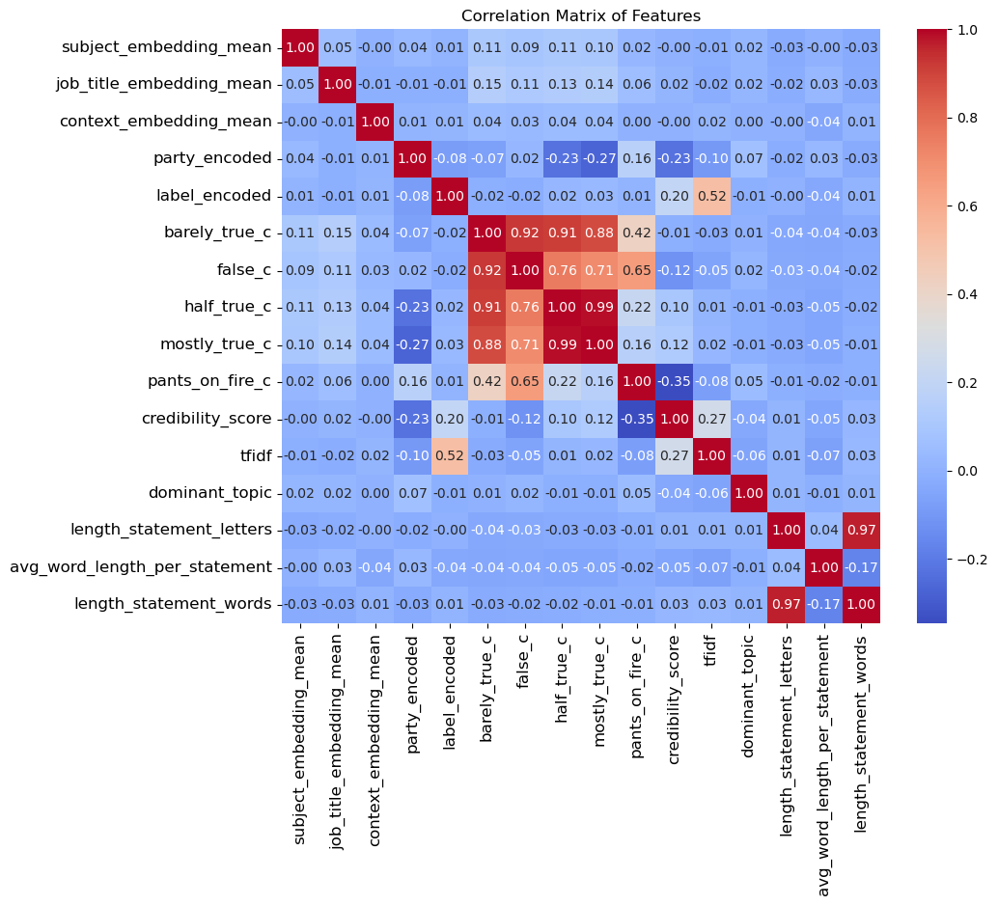
New Statistical Analysis

Slide 28
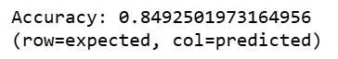
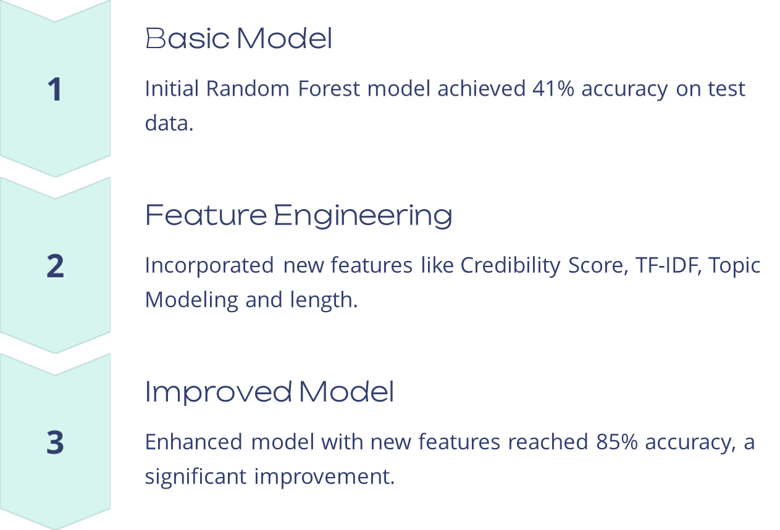

New Model: Test Accuracy
Notes:
Based on your learning from the baseline model, build a better model and analyze its performance.

Slide 29

Error Analysis - Test data set
Notes:
Build an ML model that you expect to serve as a strong baseline. Perform performance analysis and error analysis on its results, and learn from it how to make it better.

Slide 30

New Model: Feature Importance

Slide 31
Back to Initial questions :
What are the key features that influence the truthfulness of a statement?
Can we measure a speaker’s credibility using a credibility score?
Can we use Doc2Vec embeddings to capture semantic meanings of the text and improve predictions?
How do statement length and complexity correlate with truthfulness?
Can topic modeling help identify patterns between truthful and false statements?
Notes:
What questions are you trying to answer? How did these questions evolve over the course of the project? What new questions did you consider in the course of your analysis?

Slide 32

Notes:
Final Analysis: What did you learn about the data? How did you answer the questions? How can you justify your answers?

Slide 33

Questions?
Notes:
Final Analysis: What did you learn about the data? How did you answer the questions? How can you justify your answers?

